Slide 1
Essentials of Project Management
Chapter 9 - Risk Management
Unless otherwise noted, this work is licensed under a Creative Commons Attribution-NonCommercial-ShareAlike 4.0 International (CC BY-NC-SA 4.0) license. Feel free to use, modify, reuse or redistribute any portion of this presentation.

Slide 2
9.1. Learning Objectives
Distinguish between risks and issues.
Describe the role of risk management in project success.
Identify types of risks based on the project phases.
Explain the risk management process.
Describe the five responses in risk management.

Slide 3
9.2. Risk Management and Project Success
Successful project managers manage the differing perceptions of risk, and the widespread confusion about its very nature, by engaging in systematic risk management.
Image by mohamed Hassan from Pixabay

Slide 4
Risk Management and Project Success
What is Risk Management?
According to the Financial Times, risk management is “the process of identifying, quantifying, and managing the risks that an organization faces” (n.d.). In reality, the whole of project management can be thought of as an exercise in risk management because all aspects of project management involve anticipating change and the risks associated with it.

Slide 5
Risk Management and Project Success
The tasks specifically associated with risk management include
identifying the types of risk exposure within the company;
measuring those potential risks;
proposing means to hedge, insure, or mitigate some of the risks;
estimating the impact of various risks on the future earnings of the company
(Financial Times).
Notes:
Perhaps the most important risk management tool is your own ability to learn about the project. The more you know about a project, the better you will be at foreseeing the many ways the project could go awry and what the consequences will be if they do, and the better you will be at responding to unexpected challenges.

Slide 6
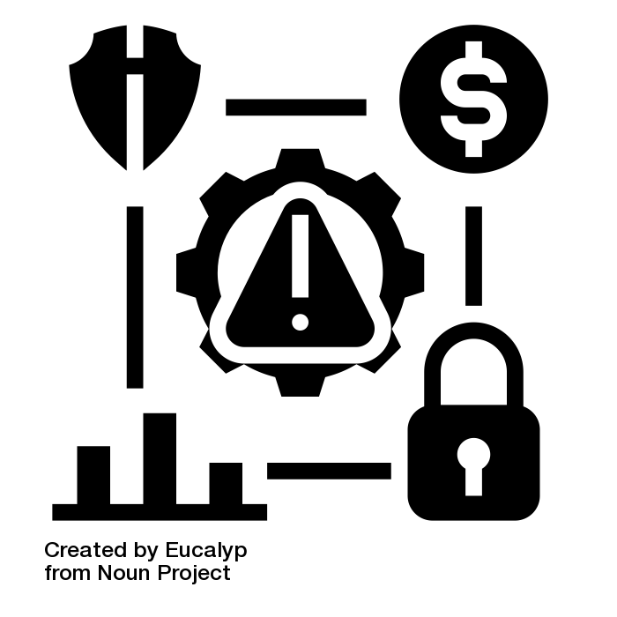
9.3. Risk Management Process
Managing risks on projects is a process that includes risk assessment and a mitigation strategy for those risks. Risk assessment includes both the identification of potential risk and the evaluation of the potential impact of the risk.
Notes:
A risk mitigation plan is designed to eliminate or minimize the impact of the risk events—occurrences that have a negative impact on the project. Identifying risk is both a creative and a disciplined process.

Slide 7
Risk Management Process I
Risk Identification
Identifying the sources of risk by category is another method for exploring potential risk on a project. Some examples of categories for potential risks include the following:
Technical Weather
Cost Financial
Schedule Political
Client People
Contractual Environmental
Notes:
You can use the same framework as the work breakdown structure (WBS) for developing a risk breakdown structure (RBS). A risk breakdown structure organizes the risks that have been identified into categories using a table with increasing levels of detail to the right.
After the potential risks have been identified, the project team then evaluates each risk based on the probability that a risk event will occur and the potential loss associated with it. Not all risks are equal. Some risk events are more likely to happen than others, and the cost of a risk can vary greatly.

Slide 8
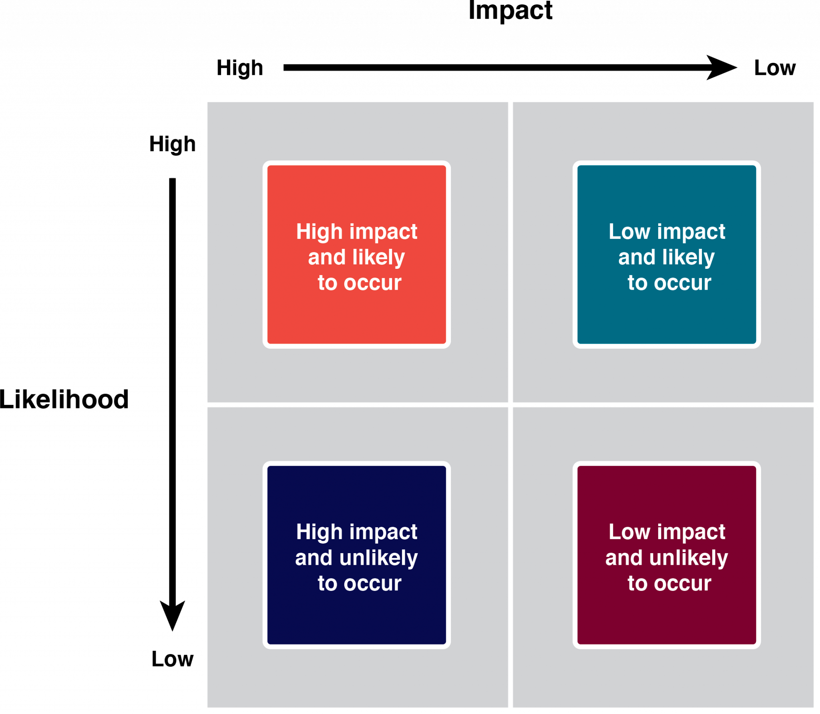
Risk Management Process II
Risk Evaluation
Risk evaluation is about developing an understanding of which potential risks have the greatest possibility of occurring and can have the greatest negative impact on the project

Slide 9
Risk Management Process
Risk Mitigation
After the risk has been identified and evaluated, the project team develops a risk mitigation plan, which is a plan to reduce the impact of an unexpected event. The project team mitigates risks in various ways:
Risk avoidance
Risk sharing
Risk reduction
Risk transfer
Notes:
Risk avoidance usually involves developing an alternative strategy that has a higher probability of success but usually at a higher cost associated with accomplishing a project task.
Risk sharing involves partnering with others to share responsibility for the risky activities.
Risk reduction is an investment of funds to reduce the risk on a project.
Risk transfer is a risk reduction method that shifts the risk from the project to another party.

Slide 10
9.4. Contingency Planning
The project risk plan balances the investment of the mitigation against the benefit for the project. The project team often develops an alternative method for accomplishing a project goal when a risk event has been identified that may frustrate the accomplishment of that goal. These plans are called contingency plans.

Slide 11
9.5. Risks in Project Phases
Project risk is dealt with in different ways depending on the phase of the project. Those phases include:
Initiation
Planning Phase
Implementation Phase
Closeout Phase

Slide 12
9.5. Ethics and Risk Management
Ethics gives guidelines for appropriate actions between persons and groups in given situations—actions that are appropriate because they show respect for others’ rights and privileges, actions that safeguard others from embarrassment or other harm, or actions that empower others with freedom to act independently

Slide 13
Key Takeaways
Risk management is “the process of identifying, quantifying, and managing the risks that an organization faces
The most important risk management tool is your own ability to learn about the project.
Project risk is dealt with in different ways depending on the phase of the project.

