Slide 1

Essentials of Project Management
Chapter 7 - Project Procurement
Unless otherwise noted, this work is licensed under a Creative Commons Attribution-NonCommercial-ShareAlike 4.0 International (CC BY-NC-SA 4.0) license. Feel free to use, modify, reuse or redistribute any portion of this presentation.

Slide 2
7.1. Learning Objectives
Discuss issues related to supply chain management and procurement throughout an enterprise.
Explain the role of building effective client-supplier relationships in procurement.
Discuss issues related to procurement waste, and describe the advantages of emphasizing value over price.
Describe different types of contracts and the types of behaviors they encourage.
Give examples of how procurement issues vary from one context/domain to the next.
Discuss issues related to sustainable procurement.

Slide 3
7.2. Procurement Management
Procurement management follows a logical order. First, you plan what you need to contract; then you plan how you’ll do it. Next, you send out your contract requirements to sellers. They bid for the chance to work with you. You pick the best one, and then you sign the contract with them.
Notes:
Once the work begins, you monitor it to make sure that the contract is being followed. When the work is done, you close out the contract and fill out all the paperwork.

Slide 4
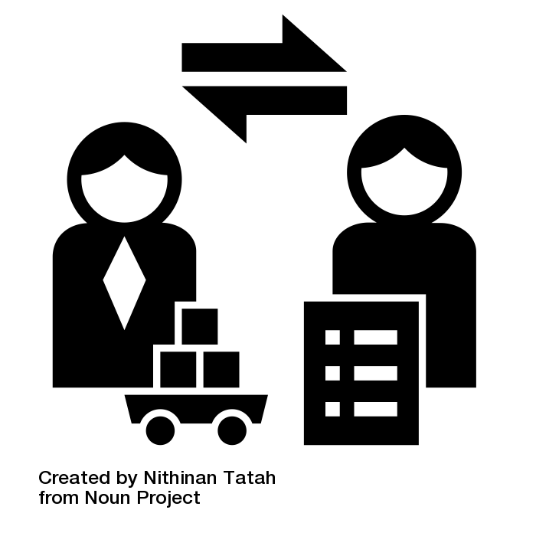
Procurement Management
The procurement management plan details how the procurement process will be managed.
Notes:
It includes:
The types of contracts you plan to use and any metrics that will be used to measure the contractors’ performance
The planned delivery dates for the work or products you are contracting
The company’s standard documents you will use
The number of vendors or contractors involved and how they will be managed
How purchasing may impact the constraints and assumptions of the project plan
The coordination of purchasing lead times with the development of the project schedule
The identification of prequalified sellers (if known)
The procurement management plan, like all other management plans, becomes a subsidiary of the project management plan. Some tools and techniques you may use during the procurement planning stage include make-or-buy analysis and definition of the contract type.

Slide 5
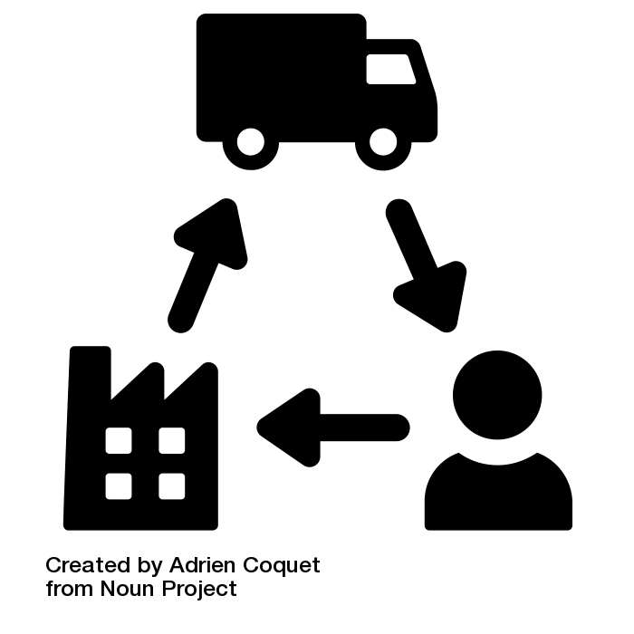
7.3. Procurement Role in Supply Chain Management
“When done well, supply chain management “results in lower costs and a faster production cycle” (Kenton 2019).
Notes:
Maintaining a healthy supply chain—that is, cultivating a network of “activities, people, entities, information, and resources” that allows a company to acquire what it needs in order to do business—is a major concern for any effective organization (Kenton 2019).
Recent threats to the American Supply Chain Industries
National and global politics: In the first half of 2019, tariffs on Chinese imports forced American companies to choose between raising prices or absorbing increased costs.
Production shutdown at key supplier: A 2018 fire at a Michigan parts plant cut off supply of parts for Ford F-150 trucks.
Changing government regulations: New restrictions on hazardous substances imposed by the European Union limited chemicals U.S. companies could import from the EU after 2017.
Extreme weather events: Flooding in Thailand in 2011 shut down computer parts factories, crippling hard drive suppliers worldwide.
Shortage of skilled manufacturing labor: Starting in 2018, American electronics suppliers found that a tight labor market meant they couldn’t produce circuit boards on schedule.

Slide 6
7.4. Make-or-Buy Analysis
This means figuring out whether or not you should be contracting the work or doing it yourself. It could also mean deciding whether to build a solution to your problem or buy one that is already available.
Notes:
Most of the same factors that help you make every other major project decision will help you with this one. How much does it cost to build it as opposed to buying it? How will this decision affect the scope of your project? How will it affect the project schedule? Do you have time to do the work and still meet your commitments?

Slide 7
7.5. Procurement Process
The project procurement cycle reflects the procurement activities from the decision to purchase the material or service through to the payment of bills and closing of procurement contracts.

Slide 8
Procurement Process
After the decision has been made to purchase goods or outsource services, the procurement team develops a plan that includes the following:
Selecting the appropriate relationships and contract approaches for each type of purchased goods or outsourced service
Preparing requests for quotes (RFQs) and requests for proposals (RFPs) and evaluating partnership opportunities
Evaluating RFQs, RFPs, and partnerships
Awarding and signing contracts
Managing quality and timely performance
Managing contract changes
Closing contracts
Notes:
Depending on the complexity level of the project, each of these steps can take either hours or sometimes weeks of work to complete. Each of these steps is also included in the project master schedule.

Slide 9
Selecting the Contract Approach
A key factor in selecting the contract approach is determining which party will take the most risk. The team determines the level of risk that will be managed by the project and what risks will be transferred to the contractor.
Notes:
Is the required work or materials a commodity, customized product or service, or unique skill or relationship?
What type of relationship is needed: supplier, vendor, or partnership?
How should the supplier, vendor, or potential partner be approached: RFQ, RFP, or personal contact?
How well known is the scope of work?
What are the risks and which party should assume which types of risk?
Does the procurement of the service or goods affect activities on the project schedule’s critical path and how much float is there on those activities?
How important is it to be sure of the cost in advance?

Slide 10
7.6. RFP and Contracts
After an idea makes it through the project selection process and becomes a funded project, an organization typically issues a request for proposal (RFP), which is a “document that describes a project’s needs in a particular area and asks for proposed solutions (along with pricing, timing, and other details) from qualified vendors.

Slide 11
Contract Types
You should know a little bit about the major kinds of contracts available to you (the client) so that you choose the one that creates the most fair and workable deal for you and the contractor.
Notes:
Some contracts are fixed price: no matter how much time or effort goes into them, the client always pay the same.

Slide 12
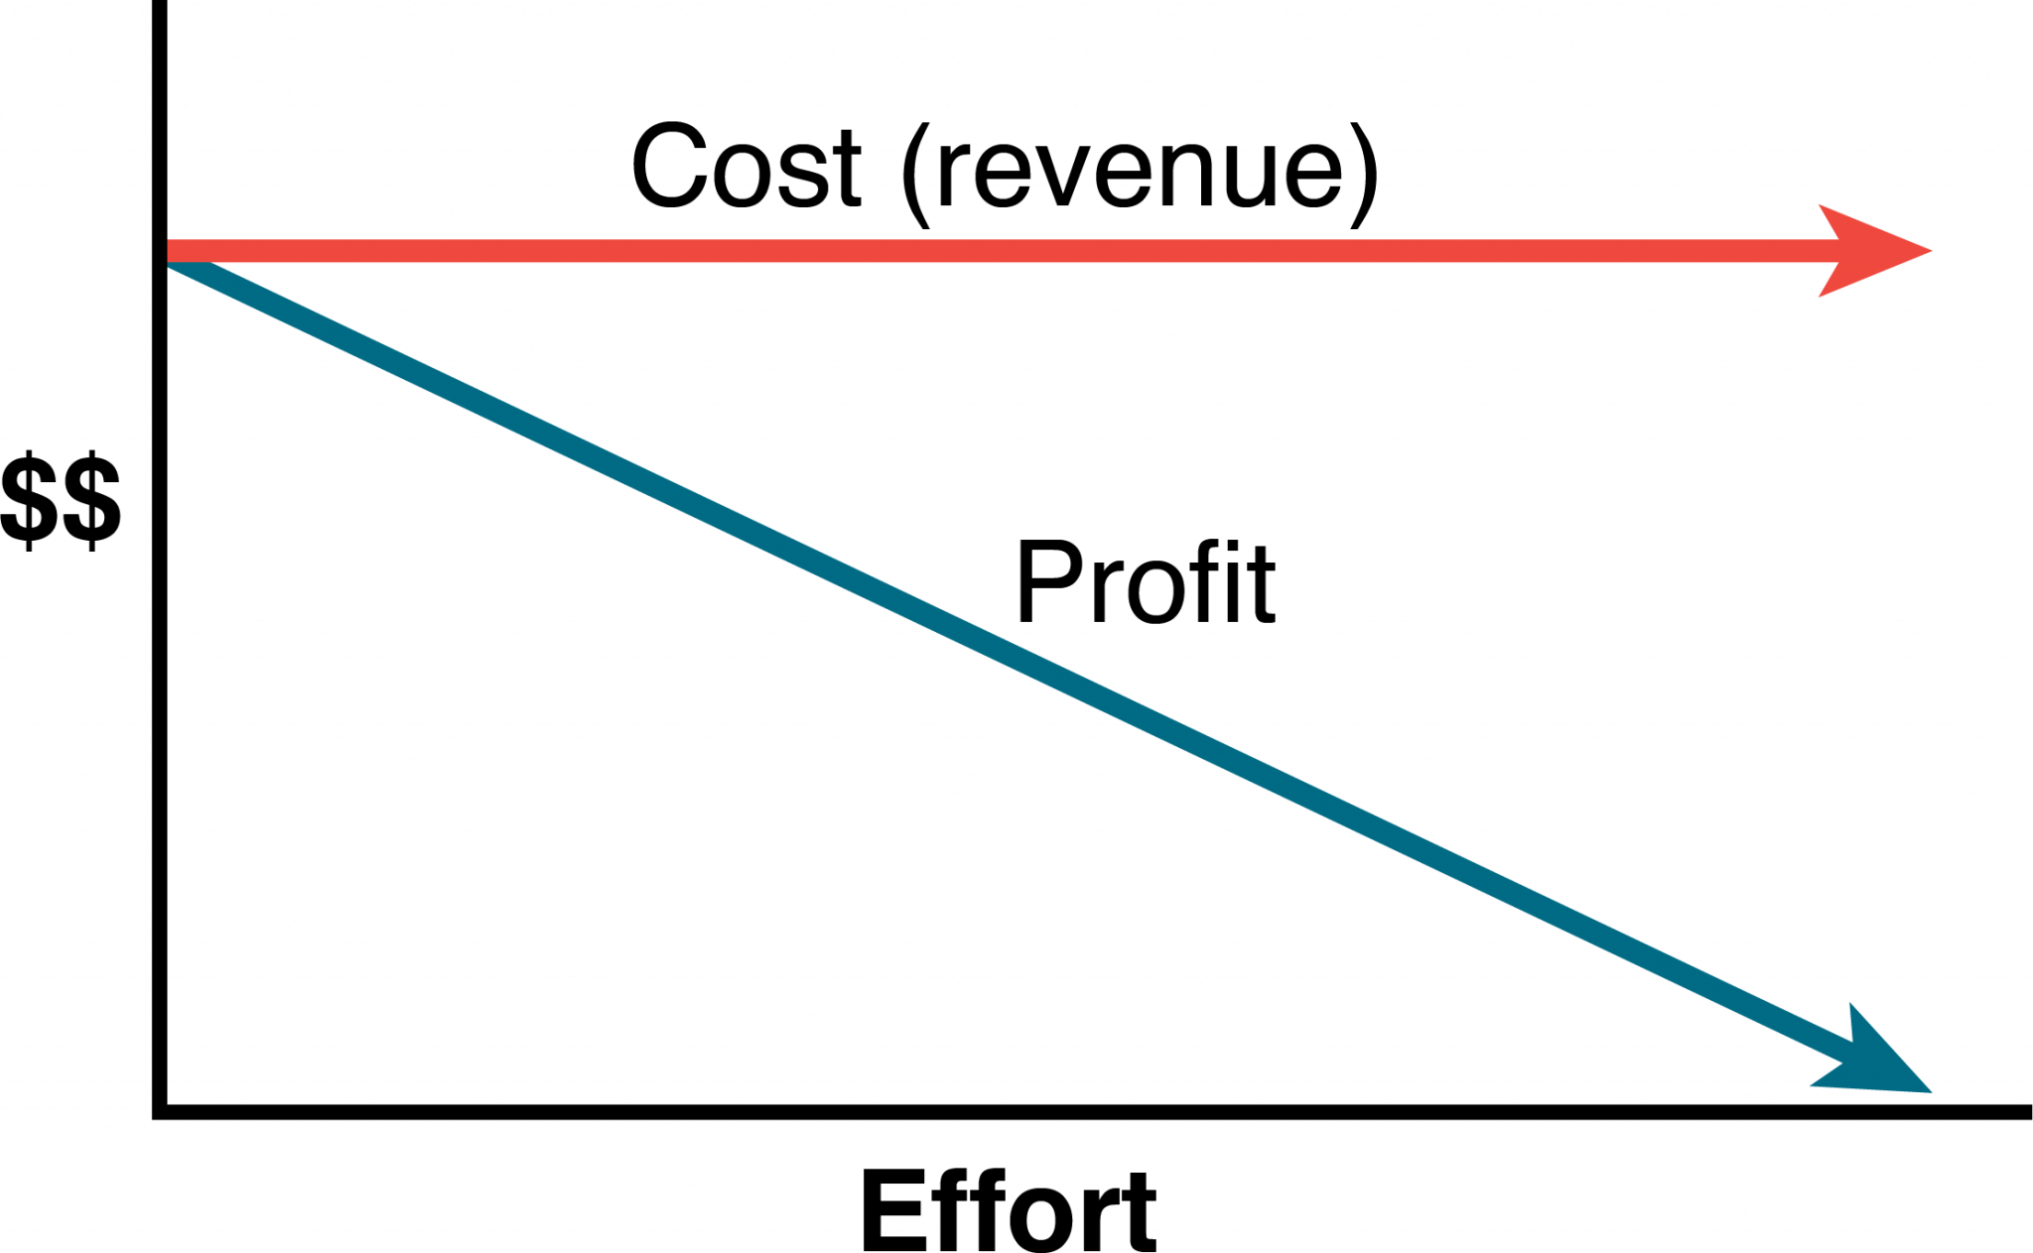
Fixed-Price Contracts
The fixed-price contract is a legal agreement between the project organization and an entity (person or company) to provide goods or services to the project at an agreed-on price.
Notes:
Fixed-price contracts require the availability of at least two or more suppliers that have the qualifications and performance histories that ensure the needs of the project can be met.

Slide 13
Cost-Reimbursable Contracts
In a cost-reimbursable contract, the organization agrees to pay the contractor for the cost of performing the service or providing the goods. Cost-reimbursable contracts are also known as cost-plus contracts.
Notes:
Cost-reimbursable contracts are most often used when the scope of work or the costs for performing the work are not well known.
Cost-reimbursable contracts require good documentation of the costs that occurred on the project to ensure that the contractor gets paid for all the work performed and to ensure that the organization is not paying for something that was not completed.

Slide 14
Key Takeaways
Procurement management follows a logical order.
Maintaining a healthy supply chain is a major concern for any effective organization.
A key factor in selecting the contract approach is determining which party will take the most risk.

