Slide 1

Essentials of Project Management
Chapter 3 – Project Process
Unless otherwise noted, this work is licensed under a Creative Commons Attribution-NonCommercial-ShareAlike 4.0 International (CC BY-NC-SA 4.0) license. Feel free to use, modify, reuse or redistribute any portion of this presentation.

Slide 2
3.1. Learning Objectives
By the end of this chapter, you should be able to:
Explain the four processes of project management.
Describe the documentations produced during the project initiation.
Describe the approach to project planning.
Identify the importance and the purpose of project planning.
Describe how project monitoring and controlling are simultaneous and continuous during project.
Identify the reasons for project closure.

Slide 3
3.2 Initiation
Project management has a dual nature; it is both a series of distinct phases with a clear beginning and end, and a continuous, circular process in which each ending leads to a new beginning.

Slide 4
Initiation
A traditional view of Project Management:
Project management can be described as a series of sequential phases, with project initiation coming right after project selection.

Slide 5
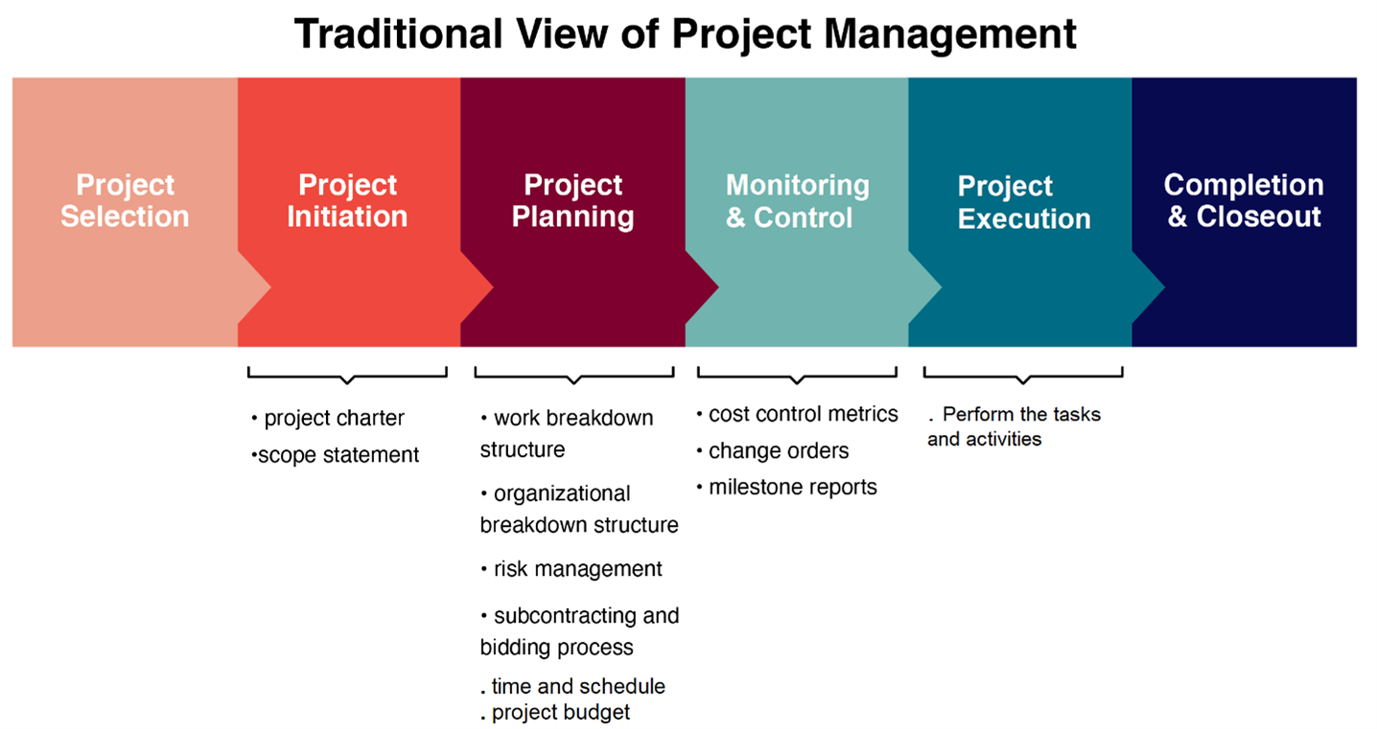
Initiation

Slide 6

3.3 Planning
Project planning is at the heart of the project life cycle, and tells everyone involved:
where you’re going
how you’re going to get there.
Image by Borko Manigoda from Pixabay
Notes:
The planning phase is when:
The project plans are documented
The project deliverables and requirements are defined
The project schedule is created.

Slide 7
Planning
The project planning phase is often the most challenging phase for a project manager, as you need to make an educated guess about the staff, resources, and equipment needed to complete your project
The purpose of the project planning phase is to:
Establish business requirements
Establish cost, schedule, list of deliverables, and delivery dates
Establish resources plans
Obtain management approval and proceed to the next phase

Slide 8
Planning
The whole point of planning is to develop strategies to manage the:
Changes to scope
Schedule
Cost
Quality
Resources
Communication
Risk
Procurement
Stakeholder engagement

Slide 9
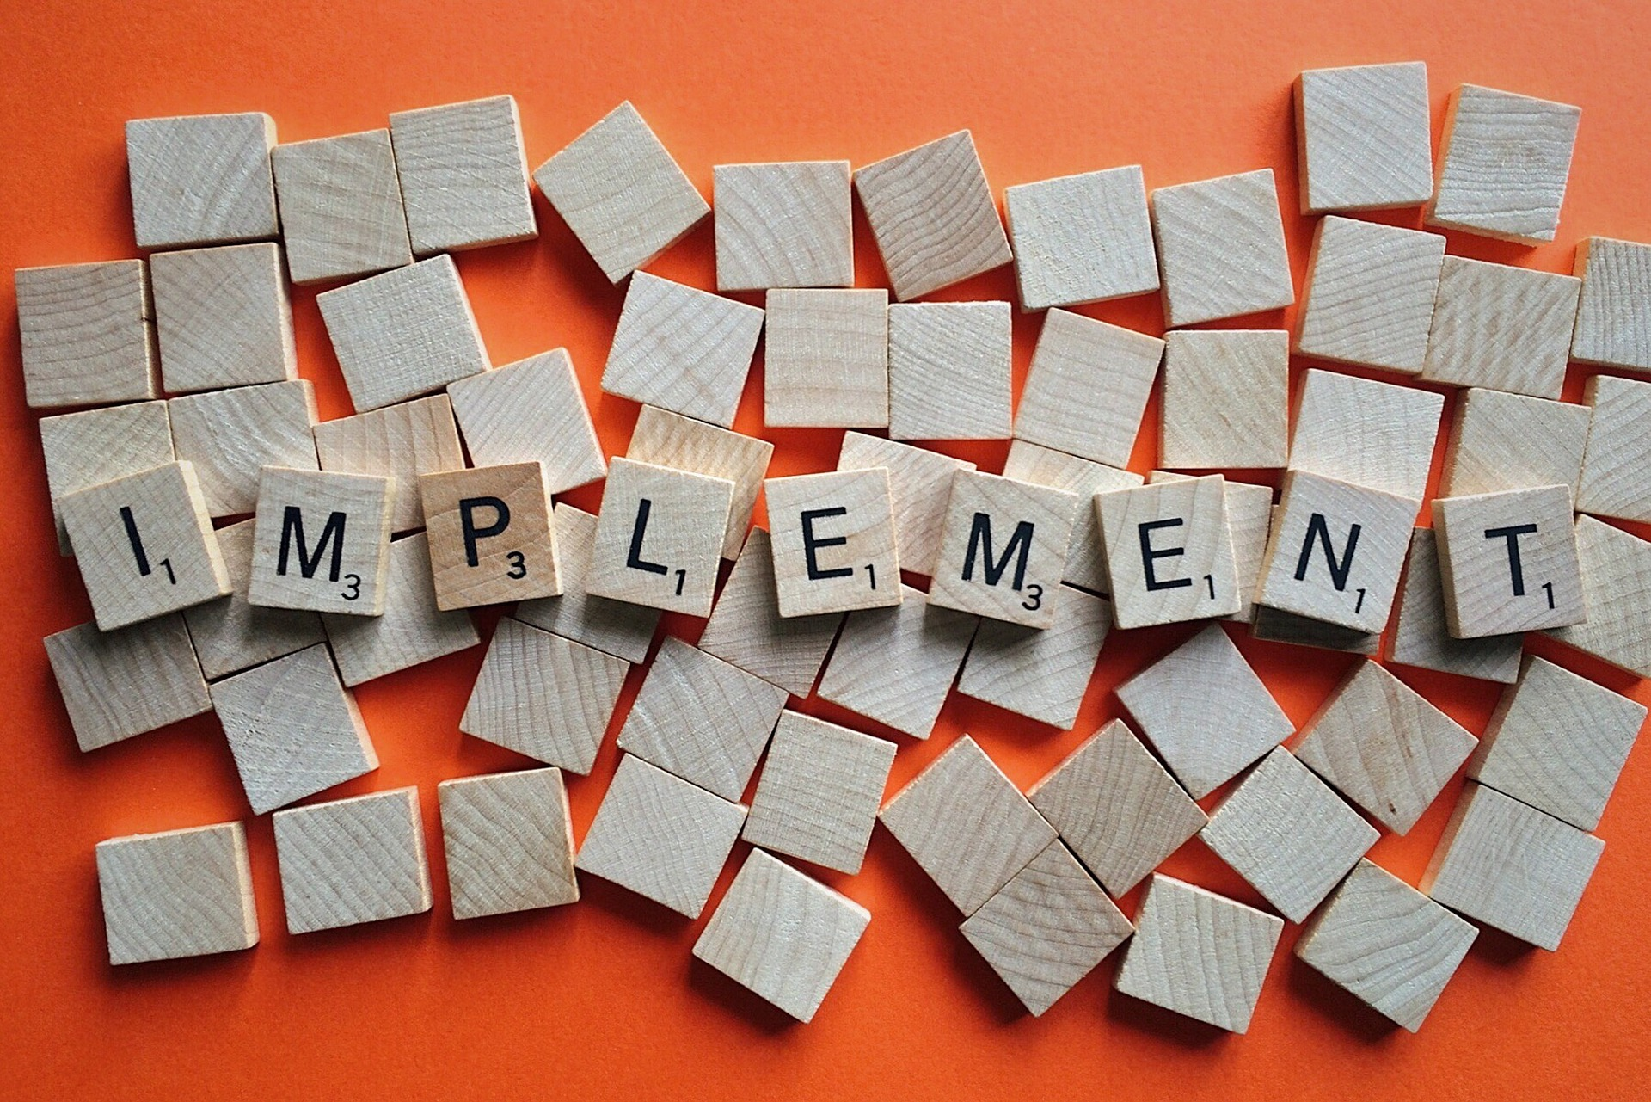
3.4 Execution
During the implementation phase, the project plan is put into motion and the work of the project is performed. It is important to maintain control and communicate as needed during implementation.
Image by Wokandapix from Pixabay

Slide 10
Execution
During project implementation, people are carrying out the tasks, and progress information is being reported through regular team meetings. The project manager uses this information to maintain control over the direction of the project by comparing the progress reports with the project plan to measure the performance of the project activities and take corrective action as needed.

Slide 11

3.5 Monitoring
Successful project managers know how to gather data on the health of their projects, analyze that data, and then, based on that analysis, make adjustments to keep their projects on track.
They practice project monitoring, analytics, and control.
Photo by Jason Strull on Unsplash
Notes:
Note: most project management publications emphasize the term monitoring and control to refer to this important phase of project management, with no mention of the analysis that allows a project manager to use monitoring data to make decisions.

Slide 12
3.6 Closure
Closing Processes
At the end of a phase of our project, or the entire project, we must get final approval from the customer, archive our records from the project, compile the lessons learned, and pay any outstanding bills.

Slide 13
Key Takeaways
Project management can be described as a series of sequential phases, with project initiation coming right after project selection.
The project planning phase is often the most challenging phase for a project manager
The plan should be updated and published on a regular basis.

