Slide 1

Essentials of Project Management
Chapter 2 - Organization
Unless otherwise noted, this work is licensed under a Creative Commons Attribution-NonCommercial-ShareAlike 4.0 International (CC BY-NC-SA 4.0) license. Feel free to use, modify, reuse or redistribute any portion of this presentation.

Slide 2
2.1. Learning Objectives
By the end of this chapter you should be able to:
Outline the different types of organizational structures
Explain the relative advantages and disadvantages of each structure as it relates to project management
Define terms related to strategy and portfolios
Discuss basic concepts related to strategy
Distinguish between strategy and operational effectiveness
Discuss issues related to aligning projects with strategy
Explain the three broad categories of projects
Identify project selection methods

Slide 3
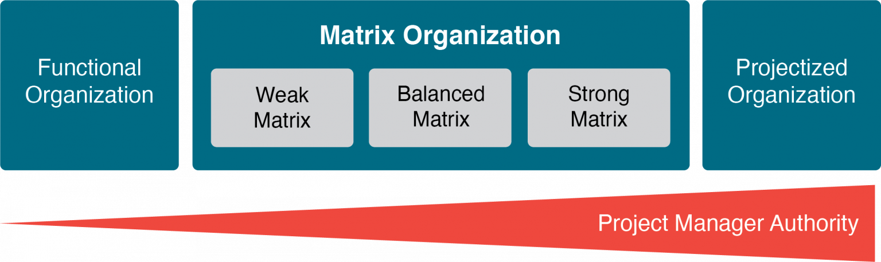
2.2 Structures
Notes:
There are three broad structures by which an organization can be organized:
Functional
Projectized
Matrix
Organizations may change their structure to increase success on a project.
They can also create a dedicated project terma which gives the same benefits without the cost, and risk.

Slide 4
Functional Organizations
Traditional functional departments might include:
Human resources
Accounting
Procurement
Marketing
Sales
Shipping
Notes:
The success of projects within a functional organization depends on functional managers working together and cooperating.

Slide 5
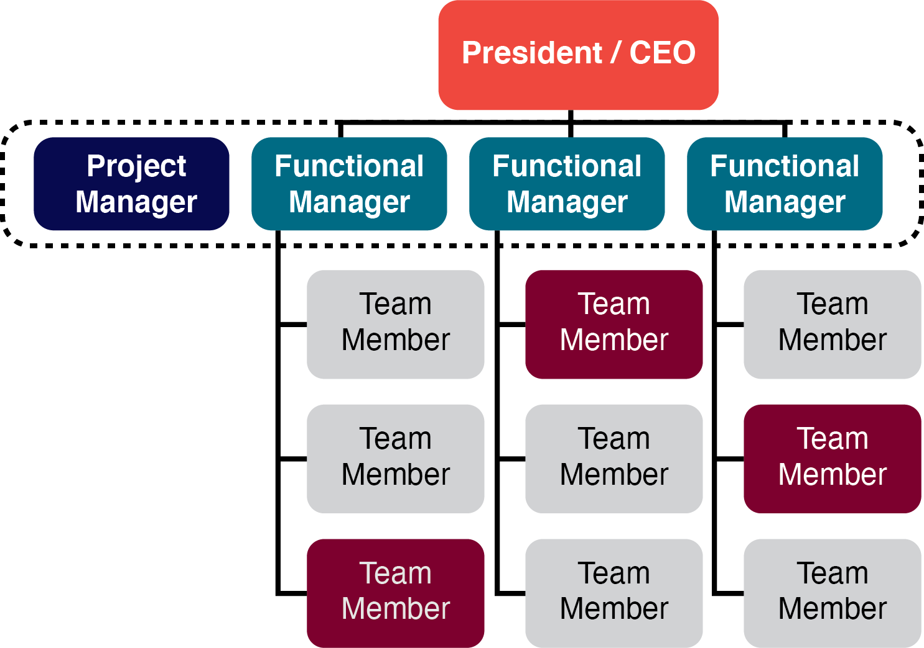
Functional Organizations
Notes:
Large organizations are traditionally organized by function into various departments, with staff in each department reporting to a departmental manager or head of department.

Slide 6
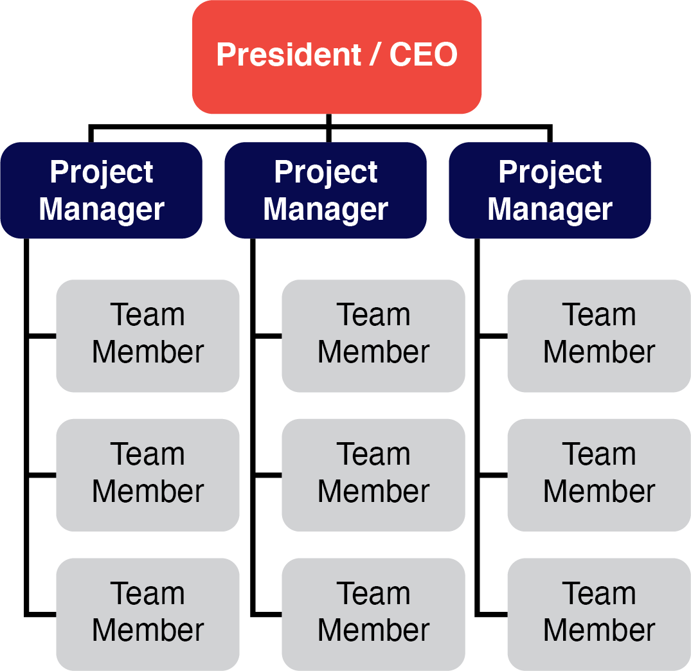
Projectized Organization

Slide 7
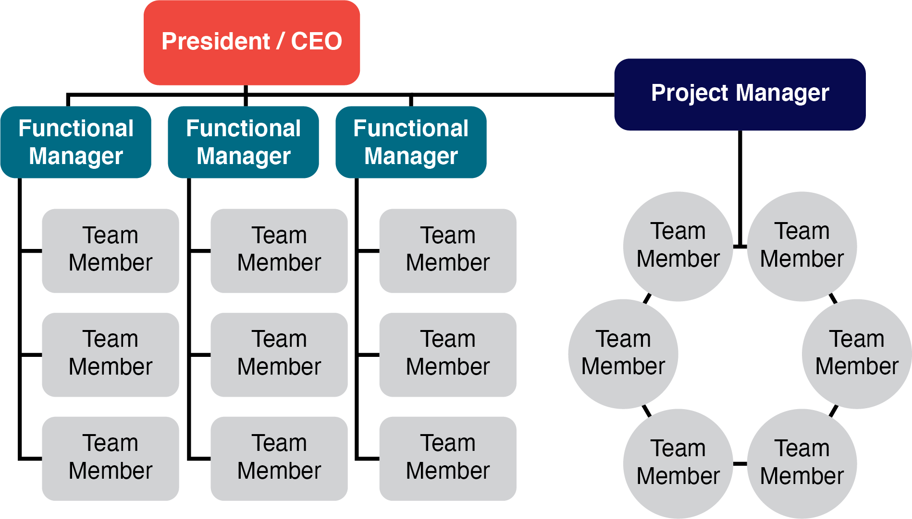
Dedicated Project Team

Slide 8
Projectized Organization
Projectized organizations are at the opposite end of the organizational spectrum from functional organizations.
In a projectized organization, operations are minimal and the project manager has great authority over resources and personnel decisions.

Slide 9
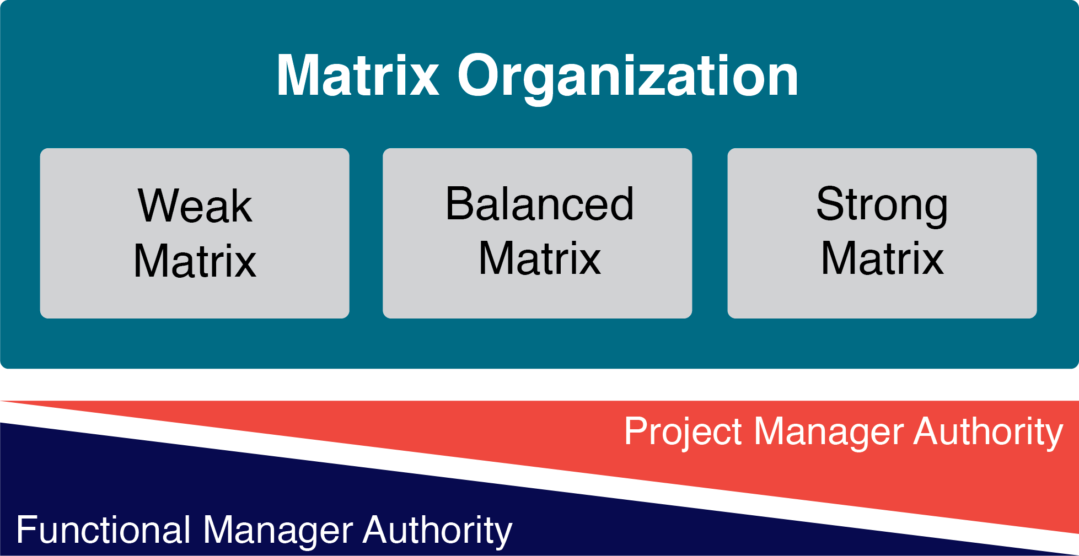
Matrix Organizations
A matrix structure tries to combine the strengths a functional organization provides for operations management with the strengths a projectized organization provides for project management.

Slide 10
2.3 Culture
What Is Organizational Culture?
Corporate (organizational) culture refers to the beliefs, attitudes, and values that the organization’s members share and the behaviors consistent with them.
Notes:
When working with internal and external customers on a project, it is essential to pay close attention to relationships, context, history, and the corporate culture.
Corporate culture sets one organization apart from another, and dictates how members of the organization will see you, interact with you, and sometimes judge you.

Slide 11

2.4 Strategy
Effective project management and execution start with choosing the right projects.
An organization’s strategy is an expression of its mission and overall culture.
Strategy is about “aligning every activity to create an offering that cannot easily be emulated by competitors” (Porter, 2001).
Notes:
The essence of strategy is that you must set limits on what you’re trying to accomplish. The company without a strategy is willing to try anything. (Hammonds, 2001)

Slide 12
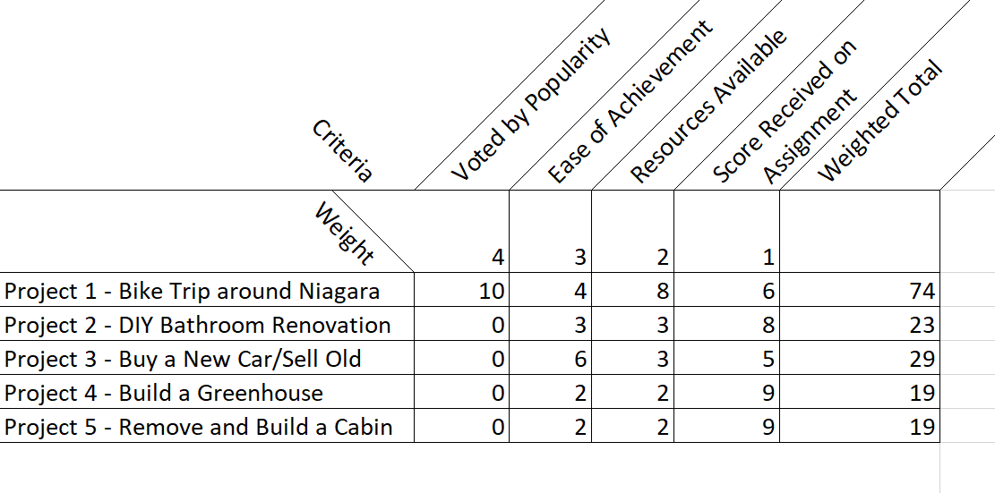
2.5 Project Selection
Factors that Affect Project Selection
In any organization, project selection is influenced by the available resources.
When money is short, organizations often terminate existing projects and postpone investing in new ones.
Project screening chart
Notes:
An organization’s project selection process is also influenced by the nature of the organization.

Slide 13

The Project Selection Process
No matter the speed at which a project selection process plays out, successful organizations typically build in a period of what Scott Anthony calls “staged learning,” in which the project stakeholders expand their knowledge of potential projects.
Image by StartupStockPhotos from Pixabay

Slide 14
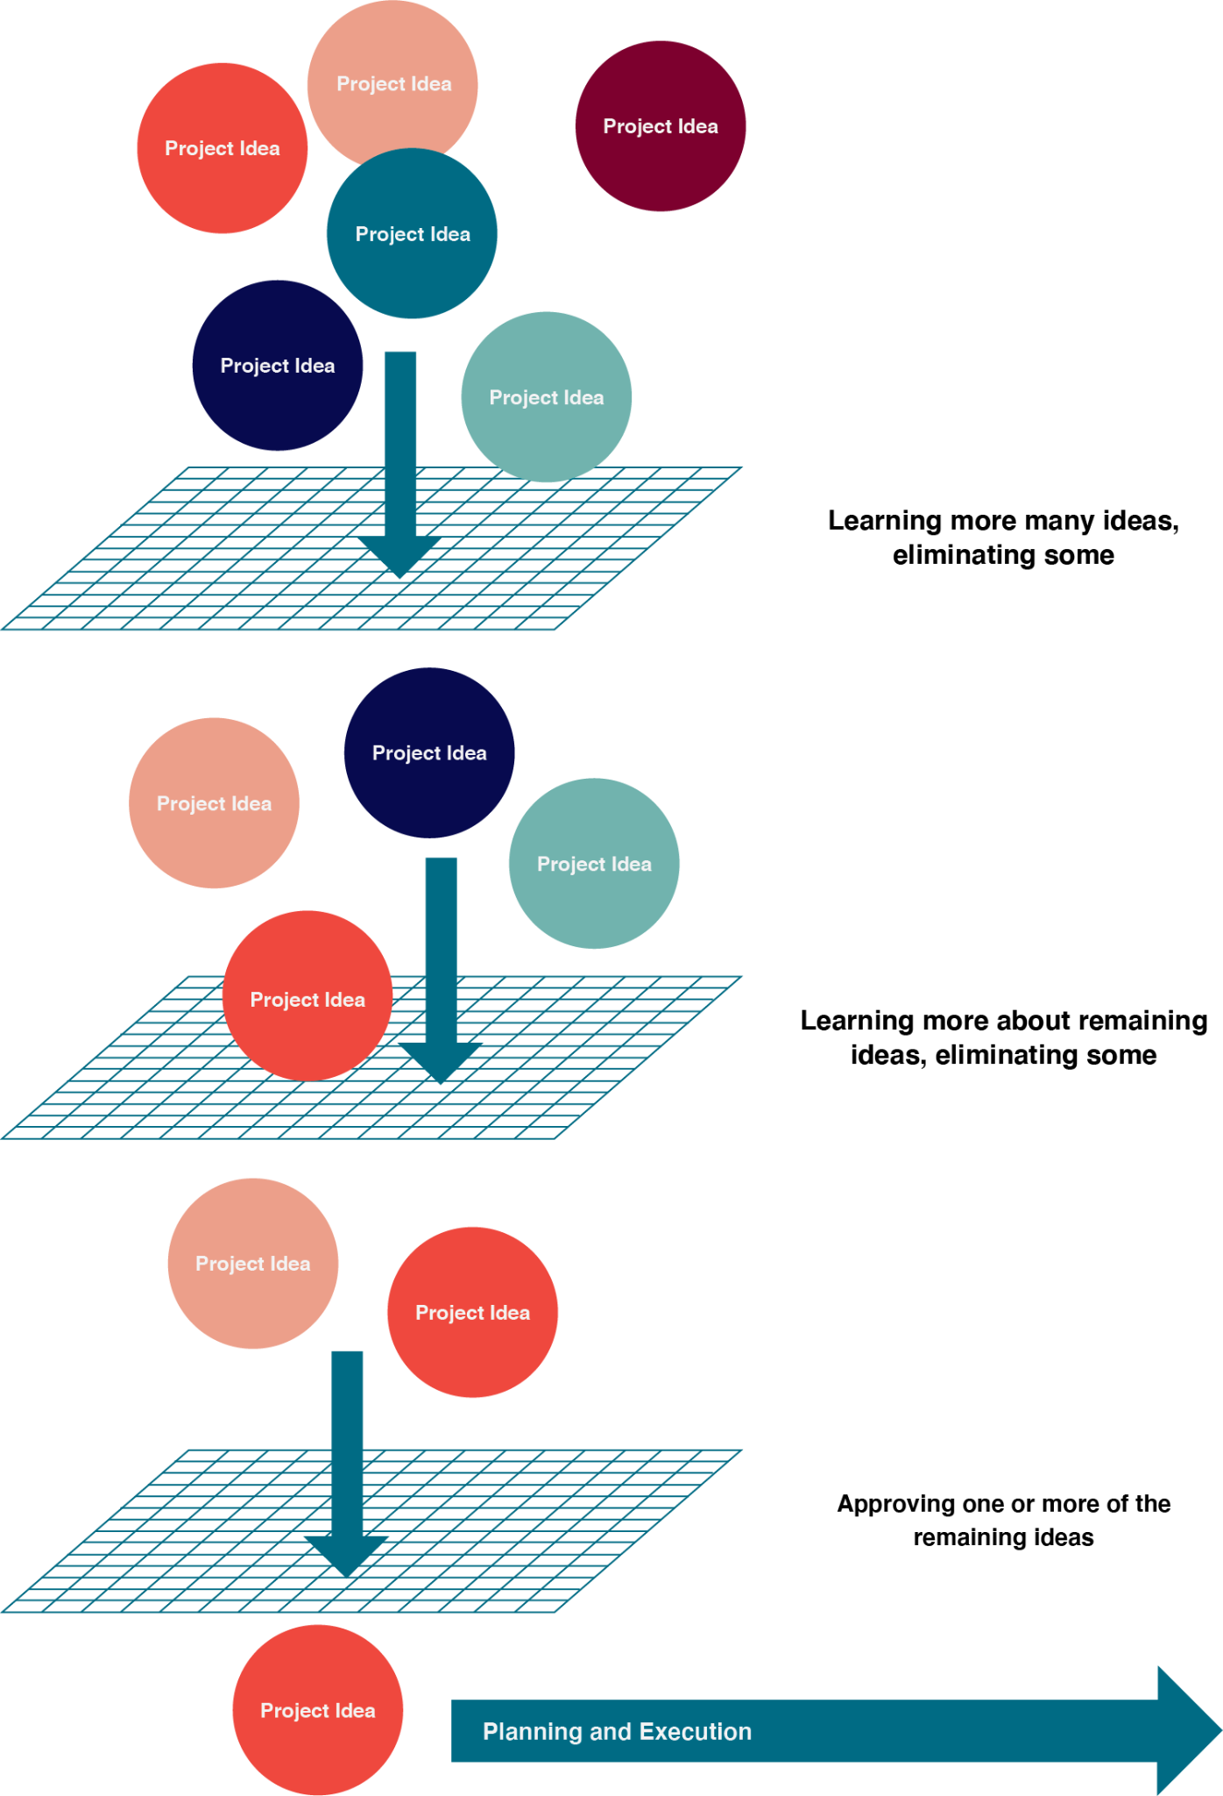
The Project Selection Process
You can think of the project selection process as a series of screens that reduce a plethora of ideas, opportunities, and needs to a few approved projects.

Slide 15
Project Selection Methods
Project selection methods can include:
Scrub Down- A group of experts attempt to “murder” a project proposal by pointing out its flaws and weaknesses.
Qualitative Scoring Methods - Scoring methods can take a variety of factors into account.
Economic Scoring Methods- These methods assess the ability of the project to help the bottom line, either by increasing profits or reducing costs.
Constrained Optimization Methods- Mathematically intensive means of analyzing a series of projects and are not easily generalized.

Slide 16
Key Takeaways
There are three broad structures by which an organization can be organized
Corporate culture sets one organization apart from another
Size is a major influence on an organization’s project selection process.
The essence of strategy is that you must set limits on what you’re trying to accomplish.

