Slide 1

Essentials of Project Management
Chapter 12 - Project Leadership
Unless otherwise noted, this work is licensed under a Creative Commons Attribution-NonCommercial-ShareAlike 4.0 International (CC BY-NC-SA 4.0) license. Feel free to use, modify, reuse or redistribute any portion of this presentation.

Slide 2
12.1. Learning Objectives
By the end of this chapter you should be able to:
Identify four roles of a project manager.
Discuss the essential skills of good project managers.
Discuss the important factors needed in managing a team.
Describe the five responses to conflict.
List advantages of teams and strong leadership.

Slide 3
12.2. Diversity and Leadership
The rationale for putting together a team is to combine different people, personalities, and perspectives to solve a problem.
Diverse teams are more effective than homogenous teams because they are better at processing information and using it to come up with new ideas.
Good teamwork depends, ultimately, on a leader with a clear understanding of what it means to lead
Notes:
The rationale for putting together a team is to combine different people, personalities, and perspectives to solve a problem. Difference is the whole point. Diverse teams are more effective than homogenous teams because they are better at processing information and using it to come up with new ideas. According to David Rock and Heidi Grant, diverse teams tend to focus more on facts, process those facts more carefully, and are more innovative (Rock, 2016). What’s more, researchers investigating creativity and innovation have consistently demonstrated “the value of exposing individuals to experiences with multiple perspectives and worldviews. It is the combination of these various perspectives in novel ways that results in new ideas ‘popping up.’ Creative ‘aha’ moments do not happen by themselves” (Viki, 2016). In his book: The Difference: How the Power of Diversity Creates Better Groups, Firms, Schools, and Societies, Scott Page (2007) puts it like this:

Slide 4

12.3. Role of PM
Adopting these four roles will set you on the road toward delivering more value in your projects, with less waste, which is also the goal of both Lean project management and Agile project management.
Develop collaboration among project participants
Integrate planning with learning
Prevent major disruptions
Maintain forward momentum
Forest Road Royalty Free Photo (negativespace.co)
Notes:
In this section we will talk about some general principles for successful project management in a living order world. Adopting these four roles will set you on the road toward delivering more value in your projects, with less waste, which is also the goal of both Lean project management and Agile project management.

Slide 5
12.4. Project Manager Characteristics I
The project manager must be perceived to be credible by the project team and key stakeholders.
The project manager must have administrative skills, organizational skills, and technical skills associated with the technology of the project.
The types of skills and the depth of the skills needed are closely connected to the complexity profile of the project.
On smaller, less complex projects, project managers need a greater degree of technical skill.
Complex projects, require more organizational skills to deal with the complexity.
Notes:
The project manager must be perceived to be credible by the project team and key stakeholders. A successful project manager can solve problems and has a high degree of tolerance for ambiguity.
When multiple people are involved in an endeavor, differences in opinions and desired outcomes naturally occur. Negotiation is a process for developing a mutually acceptable outcome when the desired outcome for each party conflicts.
For the project manager to successfully negotiate issues on the project, they should first seek to understand the position of the other party.
One of the most common issues in formal negotiations is finding a mutually acceptable price for a service or product.
Conflict on a project is to be expected because of the level of stress, lack of information during early phases of the project, personal differences, role conflicts, and limited resources

Slide 6
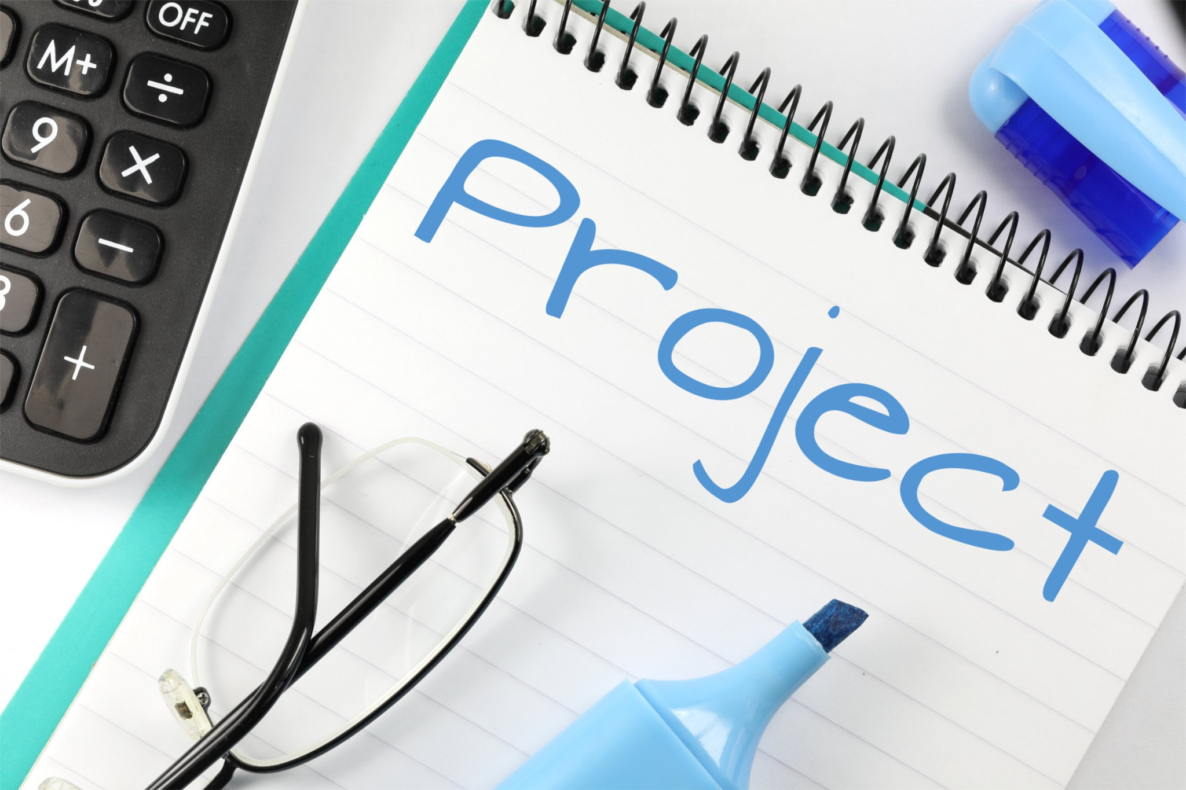
12.4. Project Manager Characteristics II
Listening - the most important skill of the project manager is to actively listen.
Negotiation - Negotiation is a process for developing a mutually acceptable outcome when the desired outcome for each party conflicts
Conflict Resolution - Good planning, communication and team building can reduce conflict.
Nick Youngson CC BY-SA 3.0 Pix4free.org
Notes:
The project manager must be perceived to be credible by the project team and key stakeholders. A successful project manager can solve problems and has a high degree of tolerance for ambiguity.
When multiple people are involved in an endeavor, differences in opinions and desired outcomes naturally occur. Negotiation is a process for developing a mutually acceptable outcome when the desired outcome for each party conflicts.
Conflict on a project is to be expected because of the level of stress, lack of information during early phases of the project, personal differences, role conflicts, and limited resources. How the project manager deals with the conflict results in the conflict being destructive or an opportunity to build energy, creativity, and innovation.

Slide 7

12.5. Managing the Team
A high-performing project team made up of individuals who are both technically skilled and motivated to contribute to the project’s outcome.
The project manager allows the team members to contribute to the project, while also fostering individual growth and accomplishment.
Managing the project team includes appraisal of employee performance and project performance.
Understanding the differences among people is a critical leadership skill.
Photo Project Team & Social Media Photos (pixabay.com)
Notes:
Employee performance includes the employee’s work results such as:
Quality and quantity of outputs
Work behavior (such as punctuality)
Job-related attributes (such as cooperation and initiative)
There are many personality-type tests that have been developed and explore different aspects of people’s personalities. It might be prudent to explore the different tests available and utilize those that are most beneficial for your team.
The Myers-Briggs identifies 16 personality types based on four preferences derived from the questionnaire. The preferences are between pairs of opposite characteristics and include the following:
Extroversion (E)-Introversion (I)
Sensing (S)-Intuition (N)
Thinking (T)-Feeling (F)
Judging (J)-Perceiving (P)
Another theory of personality typing is the DISC method, which rates people’s personalities by testing a person’s preferences in word associations in the following four areas:
Dominance/Drive—relates to control, power, and assertiveness
Inducement/Influence—relates to social situations and communication
Submission/Steadiness—relates to patience, persistence, and thoughtfulness
Compliance/Conscientiousness—relates to structure and organization

