Slide 1
Essentials of Project Management
Chapter 11 - Project Closure
Unless otherwise noted, this work is licensed under a Creative Commons Attribution-NonCommercial-ShareAlike 4.0 International (CC BY-NC-SA 4.0) license. Feel free to use, modify, reuse or redistribute any portion of this presentation.

Slide 2
11.1. Learning Objectives
By the end of this chapter you should be able to:
Discuss the importance of getting the fundamentals right and keeping them right throughout a project.
Explain the value of project reviews and audits.
Describe issues related to correcting course mid-project and decisions about terminating a project.
Discuss the project closure phase.
Recognize the importance of concluding a project with lesson learned.

Slide 3
11.2. Reasons for Closing Projects
The project must provide value to all parties.
Has the project been made obsolete or less valuable by technical advances and is
continuation still cost-effective?
Is it time to integrate the project into regular operations?
Are there better alternative uses for the funds, time, and personnel devoted to the project?
Has the market or regulatory requirements, altered the need for the project’s output?
Notes:
If an audit reveals that it’s time to terminate a project, then it’s important to realize that this is not necessarily a bad thing:
Determining whether to terminate a project can be a very difficult decision for people close to a project to make. Your perspective on a project has a huge effect on your judgment of its overall success. That is why a review conducted by an objective, external auditor can be so illuminating.

Slide 4
11.3. Contract Closing
Just as a project comes to a close contract also comes to a close.
Contract closure updates the project records, detailing the final results of the work on the project.
Contract closure process is to provide formal notice to the seller.
Nick Youngson CC BY-SA 3.0 Pix4free.org
Notes:
Quality audits have been performed during the course of the project, and the vendor was given the opportunity to make corrections earlier in the process than the closing phase. It’s not a good idea to wait until the very end of the project and then spring all the problems and issues on the vendor at once. It’s much more efficient to discuss problems with your vendor as the project progresses because it provides the opportunity for correction when the problems occur.
Procurement Contracts - The performance of suppliers and vendors is reviewed to determine if they should still be included in the list of qualified suppliers or vendors. The choice of contract for each is reviewed to determine if the decision to share risk was justified and if the choice of incentives worked.

Slide 5
11.4. Releasing the Resources
Releasing the Project Team
Is not an official process. However, it should be noted that at the conclusion of the project, you will release your project team members, and they will go back to their functional managers or get assigned to a new project.
Final Payments
If the supplier has met all the contractual obligations, including fixing problems and making repairs as noted on a punch list, the project team signs off on the contract and submits it to the accounting department for final payment.
Notes:
The final payment is usually more than a simple percentage of the work that remains to be completed. Completing the project might involve fixing the most difficult problems that are disproportionately expensive to solve, so the final payment should be large enough to motivate the vendor to give the project a high priority so that the project can be completed on time.

Slide 6
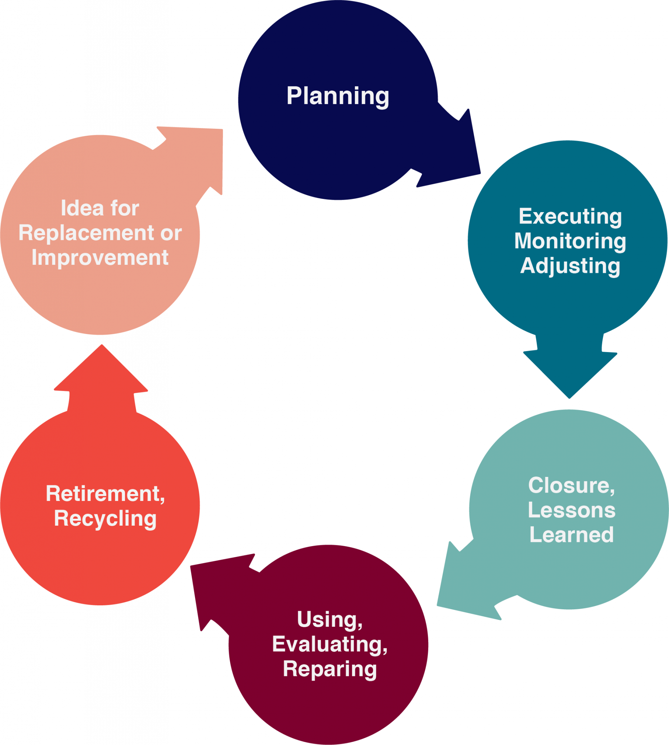
11.5. Lessons Learned
Project closure is traditionally considered the final phase of a project. It includes tasks such as:
Transferring deliverables to the customer.
Cancelling supplier contracts.
Reassigning staff, equipment, and other resources.
Finalizing project summarizing the project’s ups and downs.
Making the documentation accessible to other people in your organization.
Figure 11‑1: Seen from a living order perspective, closure is an extension of the learning and adjusting process that goes on throughout a project.
Notes:
The close-out report provides a final summary of the project performance. It should include the following:
Summary of the project and deliverables
Data on performance related to schedule, cost, and quality
Summary of the final product, service, or project and how it supports the organization’s business goals
Risks encountered and how they were mitigated
Lessons learned
If project closure is done thoughtfully and systematically, it can help ensure a smooth transition to the next stage of the project’s life cycle, or to subsequent related projects.

