Slide 1
Essentials of Project Management
Chapter 10 - Project Quality and Control
Unless otherwise noted, this work is licensed under a Creative Commons Attribution-NonCommercial-ShareAlike 4.0 International (CC BY-NC-SA 4.0) license. Feel free to use, modify, reuse or redistribute any portion of this presentation.

Slide 2
10.1. Learning Objectives
By the end of this chapter you should be able to:
Explain the importance of designing good monitoring practices.
Describe elements of effective project monitoring and controlling.
Detail how to decide what to monitor and when, and list some useful items to monitor.
Distill monitoring information into reports that are useful to different stakeholders.

Slide 3
Learning Objectives..cont
5. Describe the process of quality planning.
6. Explain how linearity bias can mislead assessment of project progress.
7. Describe the inputs required for an earned value analysis.
8. Explain a time-phased budget.
9. Calculate and interpret the various earned value
analysis metrics.

Slide 4
10.2. Quality in PM
Quality means making sure that you deliver the product as efficiently as possible.
Quality is managed on a project by setting goals and taking measurements.
Quality planning focuses on figuring out how you will measure quality and prevent defects.
You need to plan which activities you will use to measure the quality of the project’s product.
Notes:
Quality means making sure that you build what you said you would and that you do it as efficiently as you can. “Fitness to use” is about making sure that the product you build has the best design possible to fit the customer’s needs.

Slide 5
10.3. Quality Planning
The following represents the quality planning tools available to the project manager:
Cost-benefit analysis quality activities cost versus how much you will gain from doing them.
Benchmarking Using the results of quality planning on other projects to set goals for your own.
Design of experiments is the list of tests you are going to run on your product.
Notes:
High quality is achieved by planning for it rather than by reacting to problems after they are identified.
Defining and Meeting Client Expectations - Clients provide specifications for the project that must be met for the project to be successful. Recall that meeting project specifications is one definition of project success.
Sources of Planning Information Planning for quality is part of the initial planning process. The early scope, budget, and schedule estimates are used to identify processes, services, or products where the expected grade and quality should be specified. Risk analysis is used to determine which of the risks to the project could affect quality.

Slide 6
10.3. Quality Planning..cont
The following represents the quality planning tools available to the project manager:
Cost of quality cost of all the prevention and inspection activities.
Control charts can be used to define acceptable limits.
Cause-and-effect diagrams can help in discovering problems.
Quality by Nick Youngson CC BY-SA 3.0 Pix4free

Slide 7
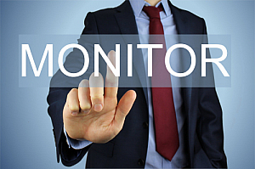
10.4. Monitoring for Active Control
Items you need to monitor will vary from project to project. If it’s important to the success of your project, you should be monitoring it” (Whited, 2014).
Projects you repeat regularly have standard processes in place.
Major milestones are helpful for monitoring important indicators.
Monitor by Nick Youngson CC BY-SA 3.0 Pix4free
Notes:
When setting up monitoring and controlling systems for a new project, it’s essential to keep in mind that not all projects are the same. What works for one project might not work for another, even if both projects seem similar. As a general rule, you should measure as often as you need to make meaningful course corrections.

Slide 8
10.5. Earned Value Analysis (EVA)
EVA measures the performance of a project in terms of cost and schedule. It can tell the project team if a project is:
Behind Schedule
Ahead of Schedule
Under Budget
Over Budget
Nick Youngson CC BY-SA 3.0 Pix4free
Notes:
EVA provides hard numbers for making these judgements and can be used to forecast where a project will end up in terms of time and cost. As a result, EVA helps the project manager clearly communicate project progress to all stakeholders, and can focus the attention of the project team on any changes needed for the project to be completed on time and on budget.

Slide 9
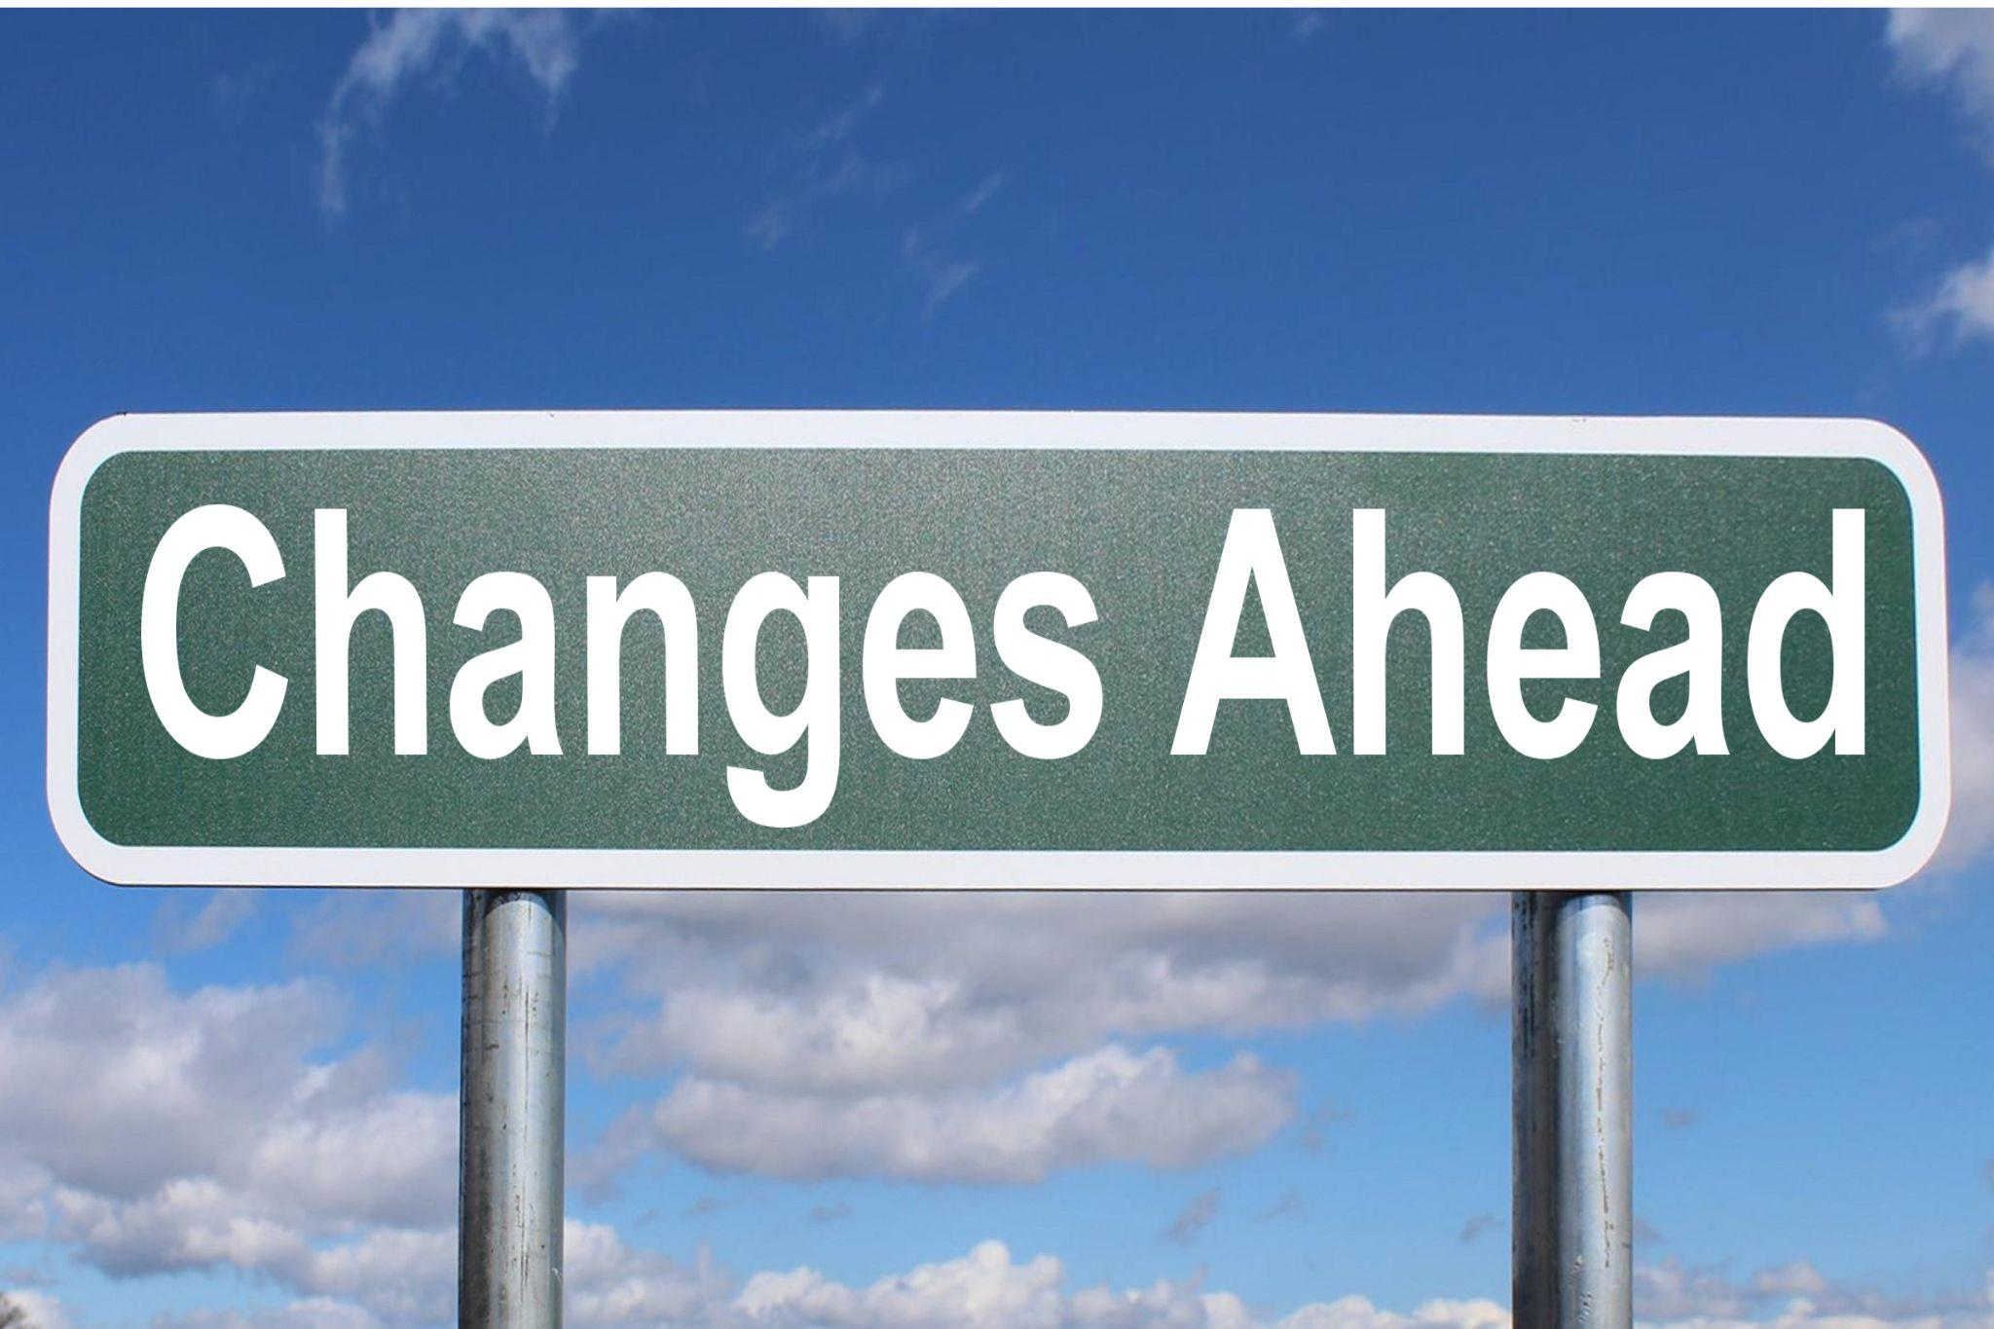
10.6. Change Control
To make a change the PM must look at how it affects the triple constraint (time, cost, scope) and how it impacts project quality.
Change control is a set of procedures that lets you make changes in an organized way.
Notes:
When you find a problem, you can’t just make a change, because it may be too expensive or take too long to do.The change request could also be submitted to the project sponsor or management for review and approval. Putting the recommended changes through change control will help you evaluate the impact and update all the necessary documents. Any time you need to make a change to your plan, you must start with a change request. When you absolutely have to meet the date and you are running behind, you can sometimes find ways to do activities more quickly by adding more resources to critical path tasks. That’s called crashing.

Slide 10
10.6. Change Control....cont
To make a change the PM must look at how it affects the triple constraint (time, cost, scope) and how it impacts project quality.
Change control is a set of procedures that lets you make changes in an organized way.

