Slide 1
Essentials of Project Management
Chapter 1 - What is Project Management?
Unless otherwise noted, this work is licensed under a Creative Commons Attribution-NonCommercial-ShareAlike 4.0 International (CC BY-NC-SA 4.0) license. Feel free to use, modify, reuse or redistribute any portion of this presentation.

Slide 2
Learning Outcomes
By the end of this chapter you should be able to:
Define the characteristics of a project.
Compare the difference between traditional and Agile project management.
Describe how program management differs from project management.
List the functions of a Project Management Office and Project Portfolio Management.
Explain the difference between a Project Lifecycle and the PMI Project Processes.
Explain the three broad categories of projects.

Slide 3
Important Note
The starting point in discussing how projects should be properly managed is to first understand what a project is and, just as importantly, what it is not.
Image by Fathromi Ramdlon from Pixabay

Slide 4
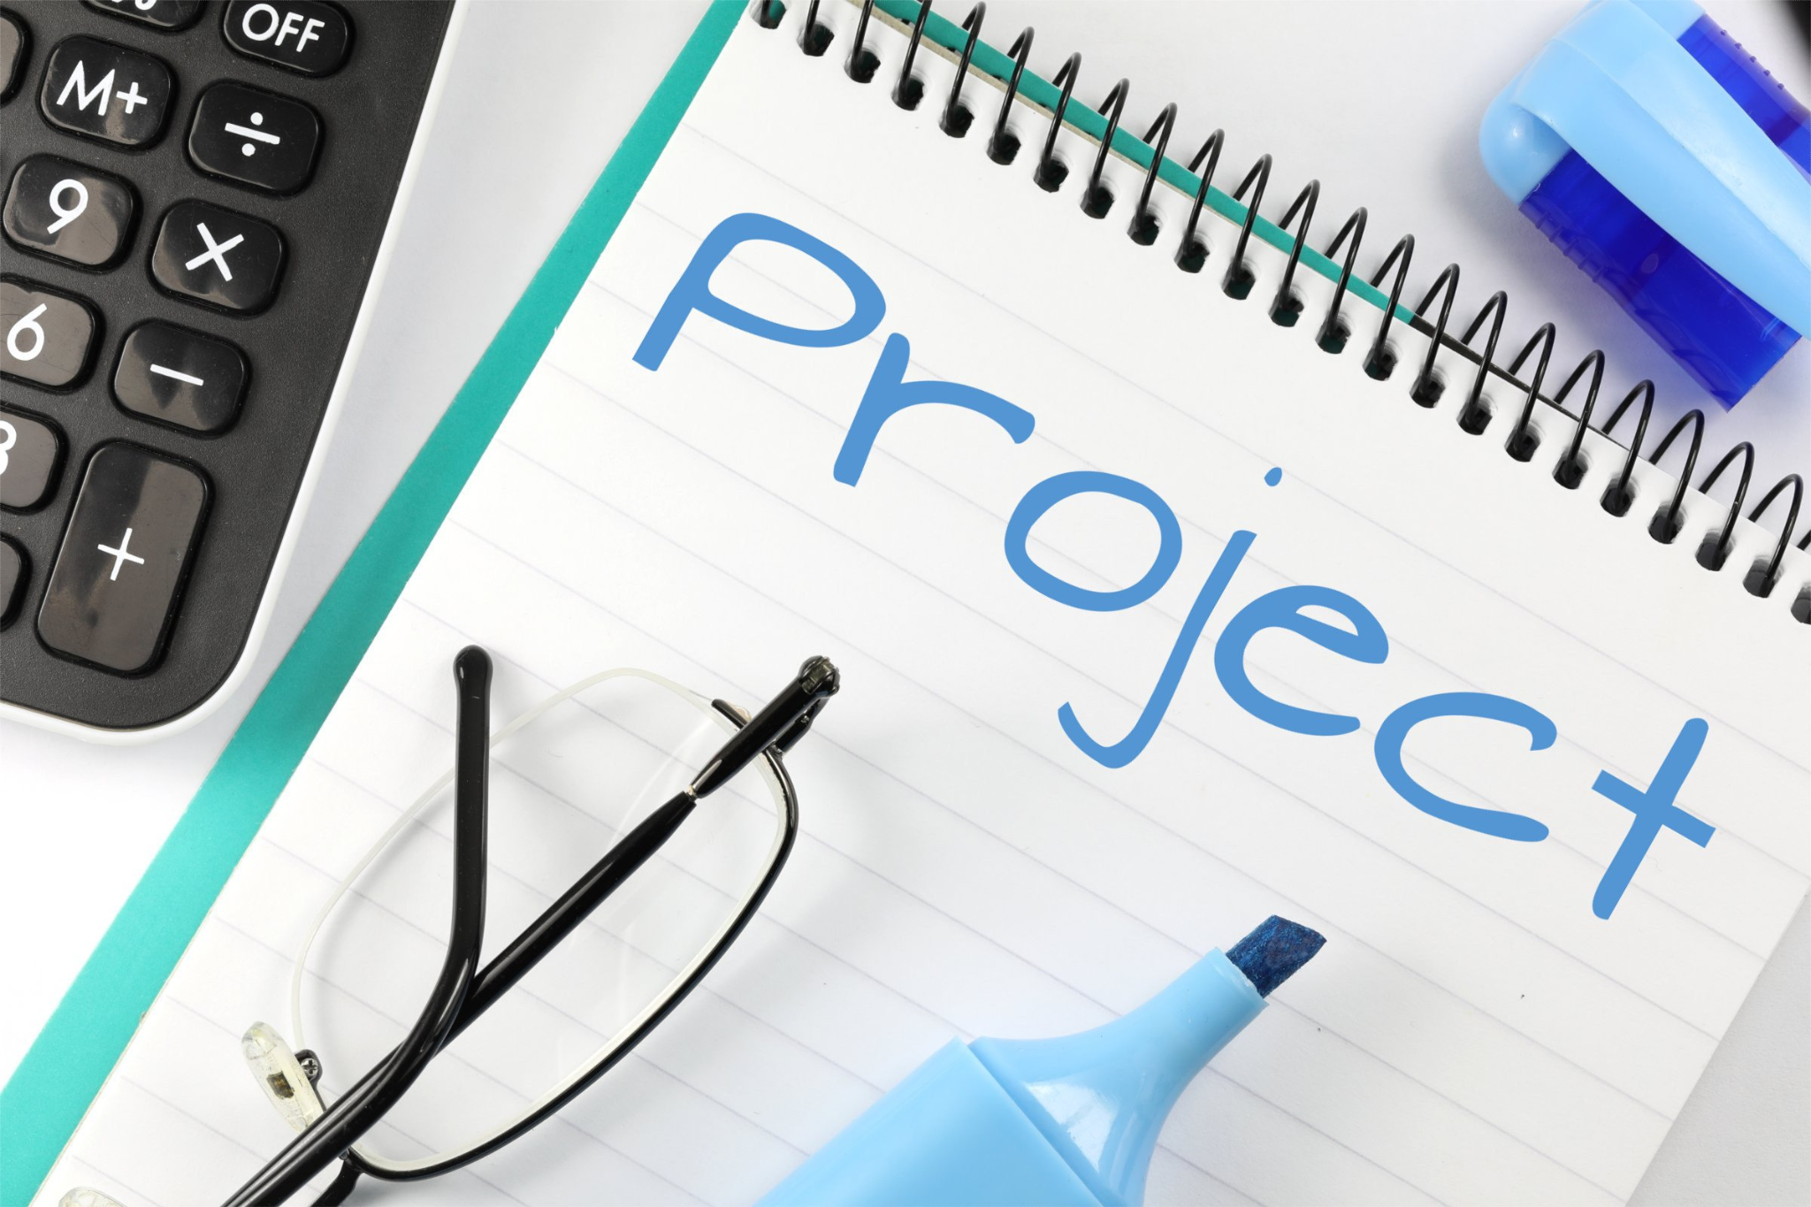
1.1 What is a Project?
A project:
is a temporary endeavor
has a specific objective
has customers or stakeholders
has constraints
has measures for success
includes some uncertainty
Beginning and end
Nick Youngson CC BY-SA 3.0 Pix4free.org
Notes:
the end is reached when the project’s objectives have been achieved or when the project is terminated because its objectives will not or cannot be met, or when the need for the project no longer exists.
Definition by Project Management Institute
Watch the video on What is a Project for more information on how these six aspects help define what a project is and is not.

Slide 5
What is a Program
Program is a collection of projects that can be conducted simultaneously or sequentially.
Example of program: diploma or a degree in supply chain/accounting/business administration.
Each subject is a project and the entire degree is the program.

Slide 6
What is an Operation?
Operations are ongoing and repetitive. They involve work that is continuous without an ending date and with the same processes repeated to produce the same results.
Nick Youngson CC BY-SA 3.0 Alpha Stock Images

Slide 7
Projects vs Operations
Projects are different from ongoing operations.
Project management addresses temporary endeavors
Operations management focuses on improving ongoing operations.
Notes:
For example, constructing a new factory is a project, while producing bicycle tires in that factory is an operation.

Slide 8
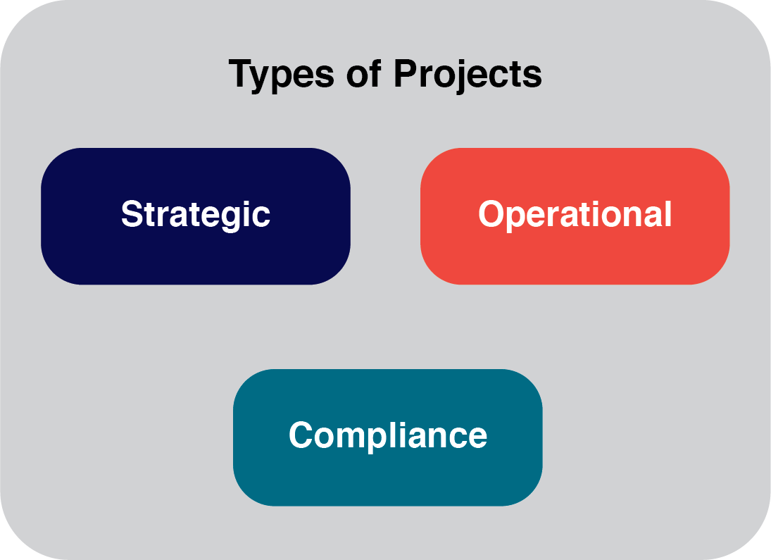
1.2 Types of Projects
Notes:
Strategic Projects involve creating something new and innovative. A new product, a new service, a new retail location, a new branch or division, or even a new factory might be a strategic project, because it will allow an organization to gain strategic advantage over its competitors.
• Operational Projects improve current operations. These projects may not produce radical improvements but[DS1] they will reduce costs, get work done more efficiently, or produce a higher quality product.
• Compliance Projects must be done in order to comply with an industry or governmental regulation or standard. Often there is no choice about whether to implement a project to meet a regulation, but there may be several project options to consider, any of which would result in meeting compliance requirements
[DS1]improvements, but

Slide 9
Traditional Project Management
Photo Credit- Eden Constantino (Unsplash)
Notes:
The post-WW2 industrial boom of the 1950s that is what project managers started to develop the tools and techniques used in modern project management. These tools were used to complete large industrial and military projects, where the scope of work (what we need to accomplish in a project) was well defined.
EXAMPLE- he scope of what we have to do can be planned out well when we are constructing an apartment building, making a nuclear submarine missile, or building an oil refinery.

Slide 10
Agile Project Management
Is iterative
Uses short development cycles
Features are reviewed and tested before delivery.
Software projects use agile approach.
Image by Markus Winkler from Pixabay
Notes:
Agile techniques use short development cycles in which features of high value are developed first and a working product/software can be reviewed and tested at the end of the cycle (20-40 days).

Slide 11
1.3 Aspects of Project Management
Project management Institute (PMI):
Non-profit organization to share best practices, and professional development opportunities.
Project Management Body of Knowledge (PMBOK) :
Codified standards for project management. Used as a reference guide.
Notes:
The PMBOK guide is organized into nine knowledge domains:
Project Integration Management
Project Scope Management
Project Time Management
Project Cost Management
Project Quality Management
Project Human Resource Management
Project Communications Management
Project Risk Management
Project Procurement Management
Project Stakeholder Management

Slide 12
Aspects of Project Management
Managing a project includes:
Identifying requirements and objectives for the project.
Balance competing project constraints.
Photo Credit- Leon Oalh (Unsplash)
Notes:
When everyone understands the goal, it’s much easier to keep them all on the right path.

Slide 13
Project Constraints
Cost: balance between “use it or lose it” budget.
Scope: purpose of the project
Quality: standards and criteria for project outcome
Time: estimates of time to complete activities

Slide 14
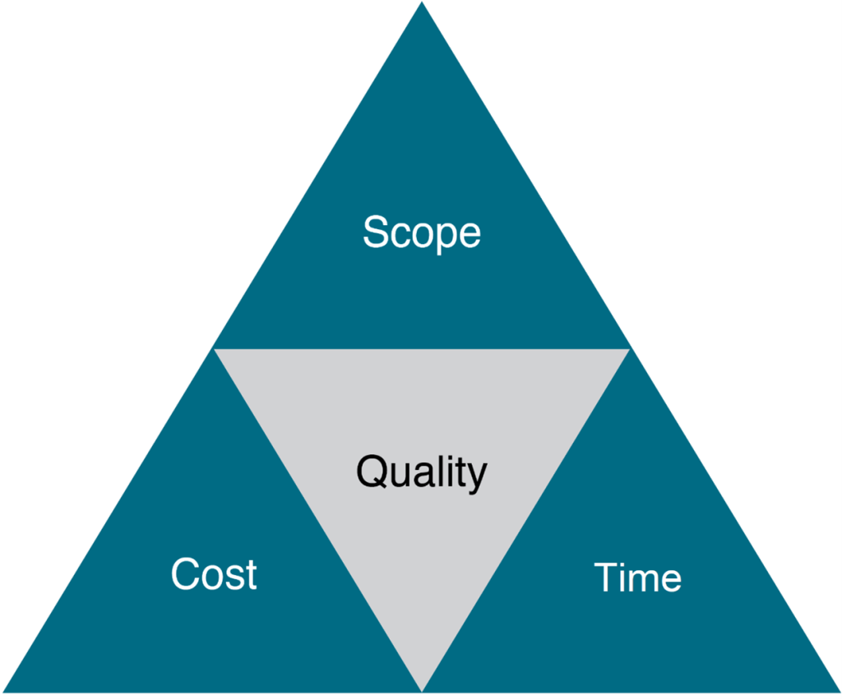
Project Priority
Notes:
These are the primary competing project constraints that you have to be most aware of. The triple constraint is illustrated in the form of a triangle to visualize the project work and see the relationship between the scope/quality, schedule/time, and cost/resource
Your project may have additional constraints that you must face, and as the project manager, you have to balance the needs of these constraints against the needs of the stakeholders and your project goals.

Slide 15
Life Cycle of a Project
The project manager and project team have one shared goal:
To carry out the work of the project for the purpose of meeting the project’s objectives.
Every project has a beginning, middle, and an ending that is either successful or unsuccessful.

Slide 16
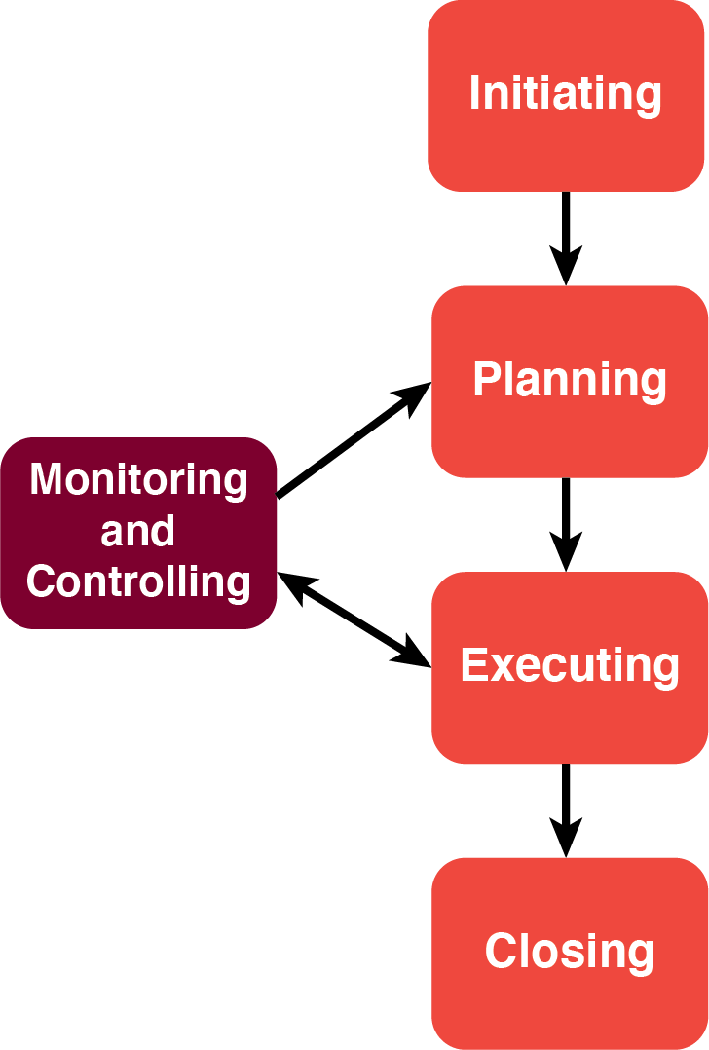
4 Phases of a Project
Initiation Phase
Planning Phase
Implementation Phase
Closing Phase
Notes:
During the first of these phases, the initiation phase, the project objective or need is identified; this can be a business problem or opportunity.
The next phase, the planning phase, is where the project solution is further developed in as much detail as possible and the steps necessary to meet the project’s objective are planned.
During the third phase, the implementation phase, the project plan is put into motion and the work of the project is performed. It is important to maintain control and communicate as needed during implementation.
During the final closure, or completion phase, the emphasis is on releasing the final deliverables to the customer, handing over project documentation to the business, terminating supplier contracts, releasing project resources, and communicating the closure of the project to all stakeholders.

Slide 17
Key Takeaways
The starting point in discussing how projects should be properly managed is to first understand what a project is and, just as importantly, what it is not.
There are three types of projects: strategic, operational, and compliance
Four main cycles of a project include initiation, planning, implementation and closing

