Slide 1
Essentials of Project Management
Chapter 13 - Project Team
Unless otherwise noted, this work is licensed under a Creative Commons Attribution-NonCommercial-ShareAlike 4.0 International (CC BY-NC-SA 4.0) license. Feel free to use, modify, reuse or redistribute any portion of this presentation.

Slide 2
13.1. Learning Objectives
By the end of this chapter you should be able to:
Outline the basic needs of our team members.
Explain the stages that a project team goes through and be able to identify the role that a project manager should try to play during each stage.
Discuss the role of trust in building a team, and describe behaviours that help build trust.
List motivators and demotivators that can affect a team’s effectiveness.
Explain issues related to managing transitions on a team.
Describe the advantages of diverse teams and provide some suggestions for managing them.

Slide 3
13.2. Successful Team
The primary reasons for project ‘dream teams’ to fail is ‘signing too many all-stars.’
More important than an all-star is project team members fully committed to the project goals.
The project teams adherence to the project goals is the key to their success.
Photo Credit- Leon Oalh (Unsplash)

Slide 4
13.3. Developing Team
The project team works with the project manager to develop the project management plans and see the project through to its successful completion.
Team members may be devoted to the management aspects of a project.
How the project team works together will determine the success or failure of a project.
Notes:
The project team works with the project manager to develop the project management plans, schedule the work of the project, acquire the needed resources, monitor project progress and see the project through to its successful completion. Team members may be devoted solely to working on the management aspects of a project, or may also be performing the work of the project. How well the project team works together will determine the success or failure of a project.

Slide 5
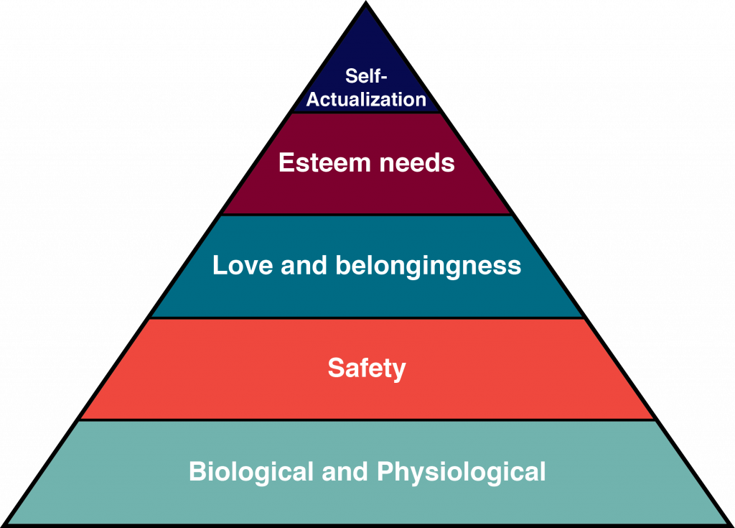
Maslow’s Hierarchy of Needs
Biological and Physiological: What a person
needs to survive, such as food, water, and shelter.
Safety: The need to be safe have financial security
and protection against accidents and illness.
Love and Belongingness: The need to be loved by one’s family and community.
Esteem: The need to be respected and valued by others.
Self-Actualization: The desire to become the best self you can
Notes:
Basic Needs: Maslow’s Hierarchy of Needs
Abraham Maslow provided a model to understand basic human needs which is usually represented as a pyramid (see Figure 13-1). Each need builds on the others: A person’s esteem needs are not that important if they are struggling with meeting the biological need to eat. Here are each of the levels in Maslow’s hierarchy:

Slide 6
Understanding Team Development
Forming: The group is brought together for the first time.
Storming:Team members are trying to figure out their roles in the group.
Norming: The team will have developed a consensus regarding roles and processes.
Performing: The group has a clear vision and purpose.
Adjourning: Project is complete. The team should collect lessons learned.
Notes:
Project managers who can quickly move the team from the Forming stage to the Performing stage will have huge advantages in terms of performance. To do this, project managers incorporate team building activities into the project.Starting the project with some team building activities will let the team start to form, resolve interpersonal conflicts and develop norms of behavior in a low-risk environment. Unfortunately, some project managers perceive taking time for team building as a waste of time. However, time invested here pays off with a much more motivated and better performing team.
Tuckman's stages of Team Development
There are lots of opportunities to incorporate team building activities into the planning process. Perhaps the most important process a project manager can facilitate is helping team members learn to trust each other.

Slide 7
13.4. Team Communication
Developing effective communication skills. To help you get started, here are a few quick resources for improving vital communication skills:
Making small talk - makes it possible for people to learn about each other.
Writing good emails - An ideal email is clear, brief, calm, and professional.
Talking one-on-one - using face-to-face conversation as the primary communication mode for your team.
Notes:
Reliable promises, emotional intelligence, and a realistic outlook are all meaningless as trust-building tools if you don’t have the skills to communicate with your team members. In his book Mastering the Leadership Role in Project Management, Alexander Laufer explains the vital importance of team communication.
Because a project functions as an ad hoc temporary and evolving organization, composed of people affiliated with different organizations, communication serves as the glue that binds together all parts of the organization. When the project suffers from high uncertainty, the role played by project communication is even more crucial. (Laufer, 2012, p. 230)

Slide 8
13.5. Team Motivation
A sense of purpose
Assigning the right tasks to the right people
Encouraging individual achievement
Sailboat rules communication, in which no one takes offense for clear direction.
Mentorship
Consistency and follow-through
Peopleimages
Notes:
To build believable performances, actors start by figuring out their characters’ motivations—their reasons for doing what they do. As a team leader, you can use the same line of thinking to better understand your team members. Start by asking this question: Why do your team members do what they do? Most people work because they have to, of course. But their contributions to a team are motivated by issues that go way beyond the economic pressures of holding onto a job.

